Slide 1


Taiwo John
09/21/25

Slide 2

Outline
Executive Summary
Introduction
Methodology
Results
Conclusion
Appendix

Slide 3
Executive Summary
Summary of Methodologies
Data: (91) Falcon 9 SpaceX launches.
Putting launch sites on an interactive Folium map to measure distances to cities and highways for risk assessment.
Dash for exploration; ML models (LogReg/SVM/DecisionTree/k-NN) tuned with GridSearchCV for prediction.
Summary of Results
Top site: KSC LC-39A — 10/13 launches successful (77%).
Payload sweet spot: (2.5–5k kg) shows a 57% success rate with 21 launches while (7.5–10k kg) also looks high (60%) but is based on only 5 launches.
Best model: Decision Tree (CV_Score=0.89; Test_Score=0.83).

Slide 4
Introduction
Project background and context
We analyze Falcon-9 first-stage landing outcomes to understand what drives success (site, payload, geography) and to build simple tools that help planning and bidding decisions.
Data used: SpaceX course CSVs (spacex_launch_dash.csv, spacex_launch_geo.csv): Launch Site, Payload Mass (kg), Booster Version Category, Class(1,0) , site lat/long.
Approach: EDA (plots + SQL), Folium map, Plotly Dash, and classification models.
Problems you want to find answers
Which site has the largest successful launches?
Which site has the highest launch success rate?
Which payload range(s) has the highest launch success rate?
Which payload range(s) has the lowest launch success rate?
Which F9 Booster version (v1.0, v1.1, FT, B4, B5, etc.) has the highest launch success rate?
Which Model Performed the Best?

Slide 5

Section 1

Slide 6
Methodology
Collected SpaceX launch records via REST API + Wikipedia web-scrape; cleaned & merged on flight/date to keep Launch Site, Payload Mass (kg), Orbit, Booster, and landing Class (1/0); scoped to Falcon-9 only and exported a curated CSV for EDA, Dash, and ML. (DATA COLLECTION)
Perform Data Wrangling by counting launches by site (CCAFS SLC-40 had the most), grouped by target orbit (ISS led with 21 launches), and converted landing outcomes into a binary Class label (1 = success, 0 = failure) for EDA and modeling.
Perform exploratory data analysis (EDA) using visualization and SQL.
Perform interactive visual analytics using Folium and Plotly Dash.
Perform predictive analysis using ML models by splitting the data into test/train, one hot encoded categoricals, standardized numeric and using LogReg/SVM/Tree/k-NN for the Models, For tuning we used GridSearchCV that picks the best estimator and for evaluation we Computed accuracy and the confusion matrix.

Slide 7
Data Collection
Collected SpaceX API + Wikipedia + site-coords data, cleaned/standardized in pandas, filtered to Falcon-9, merged and created a binary “Class” label (1=landed, 0=not), then exported a curated 91-row CSV for EDA, Dash, and ML.
API (launch JSON)
Wikipedia table
pandas DataFrames
Clean/Standardize
Filter to F9
Merge + create Class (1/0)
Curated CSV
used in EDA/Dash/ML

Slide 8
Data Collection – SpaceX API
Imports Libraries and Modules
GET launches JSON
(SpaceX/Static API)
Normalize to DataFrame
(json() → pd.json_normalize)
Pulled rocket id from each row to extract the Booster Version.
Join booster info back to the main DataFrame; select needed columns.
Filter to Falcon-9
Save CSV
(used EDA/Dash/ML)
Using pandas and requests, we fetched SpaceX launch JSON via GET, normalized it to a DataFrame, looked up each rocket’s BoosterVersion using its rocket id, merged that back with payload/launch-site fields, filtered to Falcon-9 records, and saved the curated CSV for EDA.
Here is a Github link : https://github.com/taiwotjohn13/SPACEXPROJECT/blob/main/jupyter-labs-spacex-data-collection-api-v2.ipynb

Slide 9
Data Collection - Scraping
Wiki URL
GET HTML
Parse (BS4)
Find launch table
Extract rows/cols
pandas DataFrame
Save CSV
Clean/normalize
We sent a GET request to the Falcon-9 launches page, found the main launch table, extracted its rows/columns with BeautifulSoup into a pandas DataFrame, then cleaned & normalized fields (strip refs, parse “kg”→numbers, standardize dates) using helpers like get_mass and booster_version, and saved a curated CSV for EDA/Dash/ML.
Github link: https://github.com/taiwotjohn13/SPACEXPROJECT/blob/main/jupyter-labs-webscraping.ipynb

Slide 10
Data Wrangling
Importing Libraries and Modules
Data Analysis
(Checking data type and for missing values)
Calculating the Number of Launches on Site
Calculating the number and occurrence of each orbit.
Calculate the number and occurence of mission outcome of the orbits
Create a landing outcome label from Outcome column
Exporting Dataset to Csv
imported pandas/numpy, checked data type and missing values, identify categorical fields (Launch Site, Orbit). We then counted activity: CCAFS SLC-40 launch Site had the most launches (55), and the most common orbit (destination path around Earth) was ISS.
and the most frequent landing outcome was successful ASDS (drone-ship) recovery with 41 cases. Created target label Class: 1 if landing succeeded (True RTLS/ASDS/Ocean), 0 if failed or no attempt (False…, None…).Finally Exporting Dataset to csv file format.
Github Link: https://github.com/taiwotjohn13/SPACEXPROJECT/blob/main/labs-jupyter-spacex-Data%20wrangling-v2.ipynb

Slide 11
EDA with Data Visualization
A scatter plot of Flight number(x) against the payload mass and had the points colored by success vs fail, This was used to check two ideas at once do the teams get better with experience(higher flight number = more success) and do heavier payloads make landings harder, and
A scatter plot of Flight Number(x) against the Launch Site: we used this plot to see how performances changes over time at each site.
A scatter plot of Payload and Launch Site: we used this to see if site success gaps are driven by the types of payloads flown (payload mix) rather than the site itself.
A bar chart of success rate by orbit to check whether orbit type is associated with landing success.
A scatter plot of orbit and Flight number: we used this plot To check if later flights do better (experience) within each orbit.
A scatterplot of payload mass and orbit type was used to see within each orbit, how heavier vs lighter payloads relate to landing success
A line chart of average landing success rate by year we used it To show the trend over time—i.e., SpaceX’s learning curve.
Github Link: https://github.com/taiwotjohn13/SPACEXPROJECT/blob/main/jupyter-labs-eda-dataviz-v2.ipynb

Slide 12
EDA with SQL
The Distinct query was used to get the Unique launch site in the space mission by which we had 4 launch sites.
Displayed 5 Launch Sites records where the launch site begin with ‘CCA’ it gave us record of (CCAFS LC-40, CCAFS SLC-40).
Total CRS payload: Filtered to NASA CRS missions (SQL: WHERE Payload LIKE '%CRS%') and summed PAYLOAD_MASS__KG_ (SQL: SUM) → 111,268 kg.
Booster-specific payload: Filtered to F9 v1.1 (SQL: WHERE Booster_Version LIKE 'F9 v1.1%') and averaged PAYLOAD_MASS__KG_ (SQL: AVG) → ≈2,534.7 kg.
First ground-pad success: Filtered Landing_Outcome for Success + ground pad (SQL: WHERE ... LIKE), then took earliest date (SQL: MIN(Date)) → 2015-12-22.
WHERE Landing_Outcome LIKE ‘%Success%’ AND ‘%drone ship%’ AND payload 4000–6000→ boosters with successful drone-ship landings in that payload range.
SELECTED THE MISSION OUTCOME(SELECT),Grouped it(GROUP BY) and counted each of the value count(Count(*) AS total) and rename as Total
SQL (2015 drone-ship failures): Filtered 2015 rows and picked landing outcomes containing “failure” + “drone”; using substr(Date,6,2) for month. Result: Jan (01) – F9 v1.1 B1012, CCAFS LC-40; Apr (04) – F9 v1.1 B1015, CCAFS LC-40.
Github Link: https://github.com/taiwotjohn13/SPACEXPROJECT/blob/main/jupyter-labs-eda-sql-coursera_sqllite.ipynb

Slide 13
Build an Interactive Map with Folium
Created a Folium map object with an initial center location to be NASA Johnson Space Center at Houston, Texas. Folium needed a starting map and a familiar center spot in the U.S so when the map opens you are already near Florida.
Added a circle for each launch site in the dataframe, we used Folium Circle to create the circle and used Marker to give a text label. We drew a visible circle to highlight each site’s location/area and added a labeled marker so viewers can instantly identify the site and use it for distance/route analyses later.
We plotted every launch as a green/red marker (Folium Marker + Icon) and clustered overlapping pins (MarkerCluster), so you can quickly see success vs. failure at each site without a crowded map.
Used folium.plugins.MousePosition to read lat/long anywhere on the map, Then Wrote a Haversine function (calculate_distance) to measure km from the launch site to coastline, railway, highway, and nearest city. Drew a folium. Polyline between the site and each picked point. Added a Marker/DivIcon label to show the distance. We did this because this shows the sites are near the coast and kept away from cities/roads—good for safety and logistics.
Example result: CCAFS LC-40 at (28.5623, −80.5774) — drew a 1-km circle (Folium Circle) and a labeled marker (Folium Marker + DivIcon). Used this point as the anchor to measure distances: 0.95 km to coastline, 13.05 km to nearest highway, 21.12 km to railway, and 54 km to the nearest city (via PolyLine from site to each point).
Github Link: https://github.com/taiwotjohn13/SPACEXPROJECT/blob/main/lab-jupyter-launch-site-location-v2.ipynb

Slide 14
Build a Dashboard with Plotly Dash
Built a Plotly Dash app to explore Falcon-9 landings by site and payload. We did this To let stakeholders interactively explore site × payload scenarios, see success rates instantly, and spot the payload.
Plots & Widgets
Site dropdown (dcc.Dropdown id="site-dropdown") – choose All Sites or a specific launch site. This help us so users can filter the visuals by launch site—compare sites or focus on one updating the pie (success vs. failure for that site) and the scatter (payload vs. outcome) while avoiding cross-site mixing.
Payload slider (dcc.RangeSlider id="payload-slider") – filter to a payload-mass range. This help us so users can focus on a specific payload range—see how success changes with mass.
Success pie chart (dcc.Graph id="success-pie-chart") – All Sites: pie of total successes by site (sum of class), One site: pie of Success vs Failure for that site. This was done because all site view compare which sites contribute most successes briefly, while single site view shows that site success vs failure.
Payload vs Outcome scatter (dcc.Graph id="success-payload-scatter-chart") – x = payload (kg), y = success (0/1), color = booster/version (or site), with hover details. This was done to see how payload mass relates to landing success and spot patterns by booster/site.
Github Link : https://github.com/taiwotjohn13/SPACEXPROJECT/blob/main/Dash.ipynb

Slide 15
Predictive Analysis (Classification)
Two datasets
DATA PREPROCESSING
TRAIN/TEST SPLIT
MODEL TRAIN
(LogReg/SVM/Tree/k-NN)
GridSearchCV
(5-fold)
Select best score and Params
Evaluate on test (accuracy, CM, P/R)
Save model
Built: created the target y = Class and a numeric feature matrix X (one-hot encoded categoricals, standardized numerics), then did an 80/20 train–test split and instantiated four scikit-learn classifiers—Logistic Regression, SVM, Decision Tree, and k-NN—inside a pipeline so preprocessing is fit only on the training data.
Evaluated: Tested each tuned model on the held-out test set using accuracy and the confusion matrix to compare performance and error types.
Tuning and Improvment: For each pipeline, ran GridSearchCV (cv=10, scoring=‘accuracy’, refit=True) over model-specific hyperparameters; GridSearch picks the best settings per model.
Decision rule: Pick the model with the highest CV accuracy score.

Slide 16
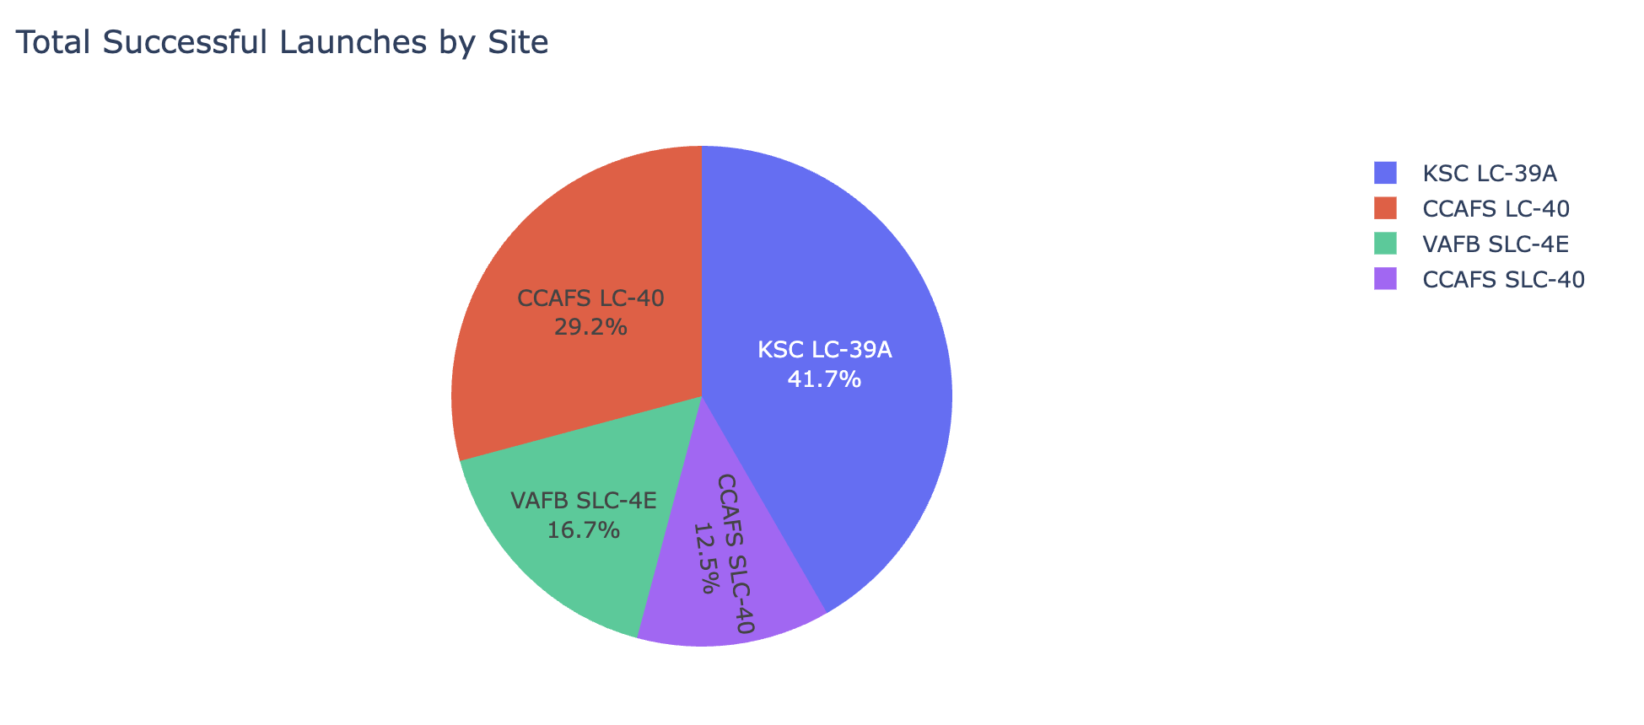
Results
Most active site: CCAFS SLC-40 with 55 Falcon-9 launches.
Most common orbit: ISS (21 missions).
Landing outcomes: ASDS (drone-ship) successes = 41.
Flight number vs launch site: : Early failures at CCAFS SLC-40; success improves after moving to KSC LC-39A and later improves back at CCAFS.
Flight Number vs Payload (colored by outcome): Success increases with experience; very heavy payloads are less likely to land.
Success rate by Orbit (bar): Highest for ES-L1/GEO/HEO, lower for GTO/SO (small-sample orbits noted).
Payload vs Launch Site: VAFB SLC-4E has no >10,000 kg payloads; payload mix differs by site.
Yearly trend (line): Average success climbs from near 0 (pre-2014) to 0.9 by 2019–2020.
Model | CV accuracy | Test accuracy
Logistic Regression | 84.6% | 83.3%
SVM | 84.8% | 83.3%
Decision Tree | 88.8% | 83.3%
k-NN | 84.8% | 83.3%

Slide 17

Section 2

Slide 18
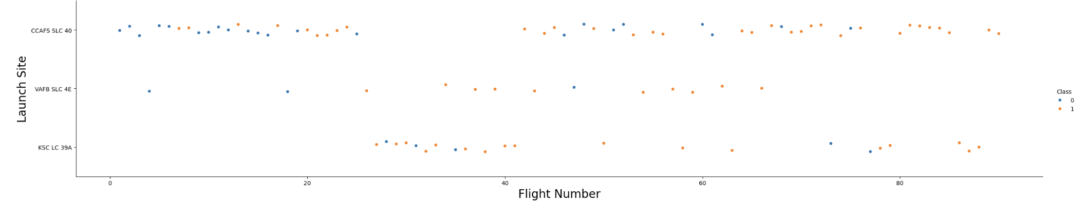
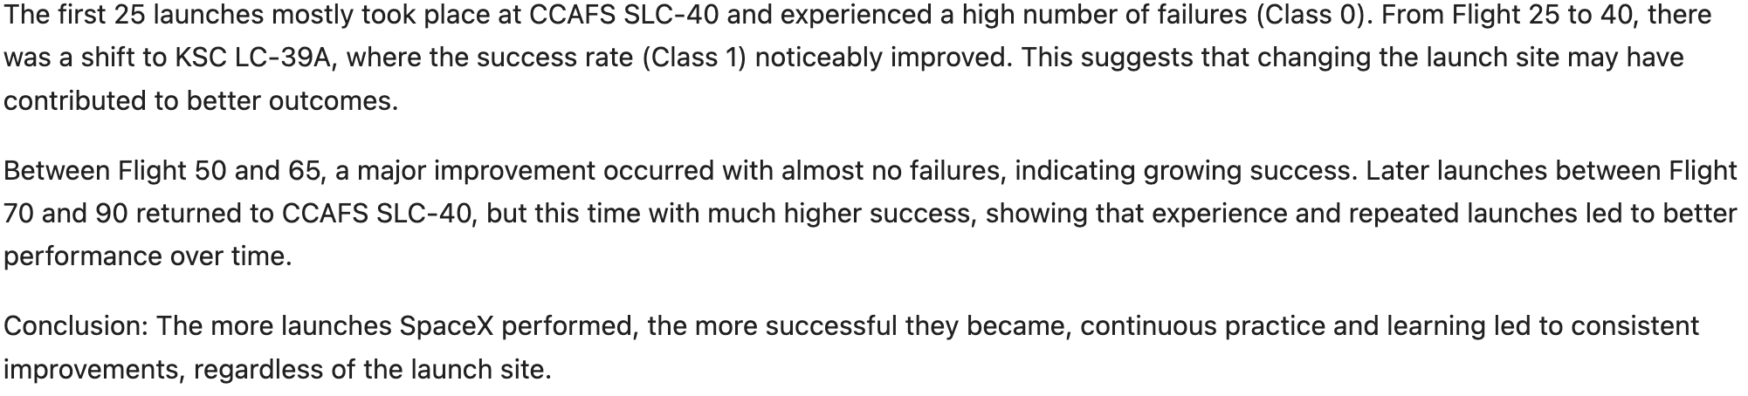
Flight Number vs. Launch Site

Slide 19
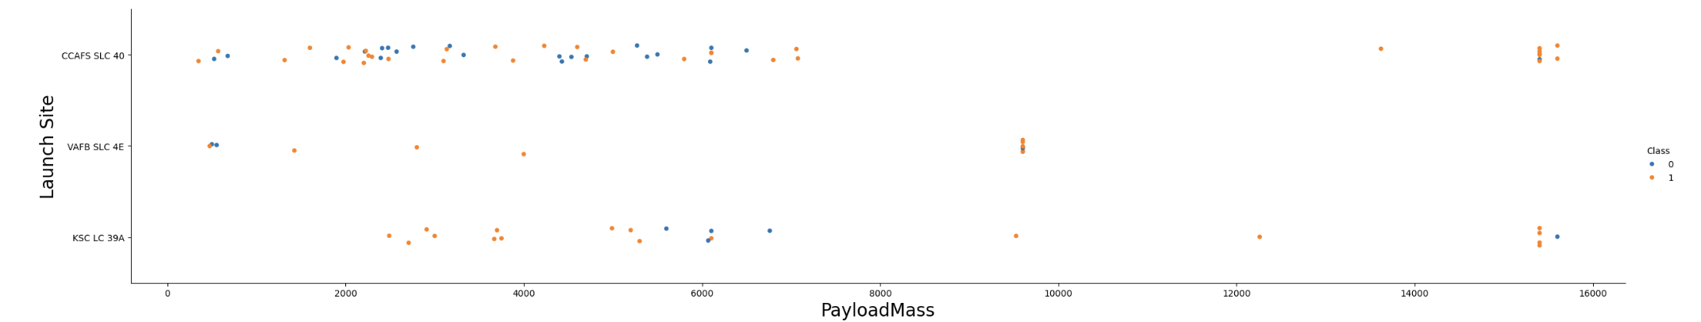
Payload vs. Launch Site

Slide 20
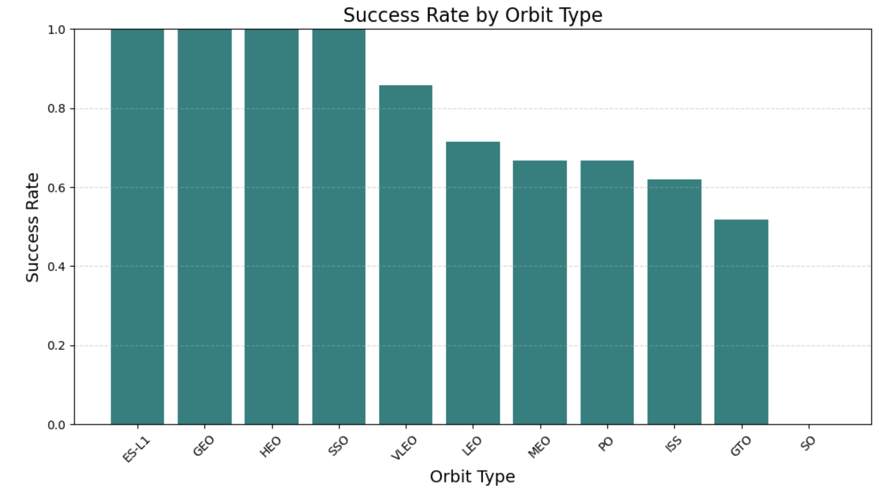
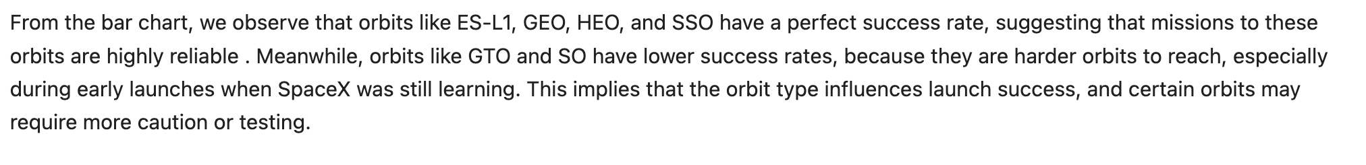
Success Rate vs. Orbit Type

Slide 21
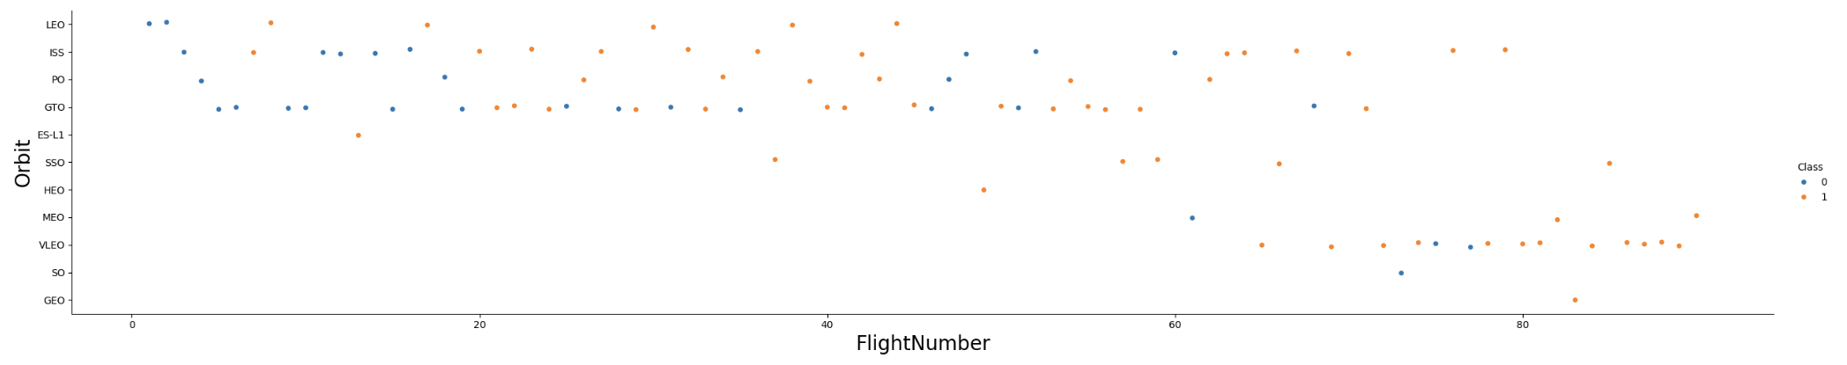
Flight Number vs. Orbit Type

Slide 22
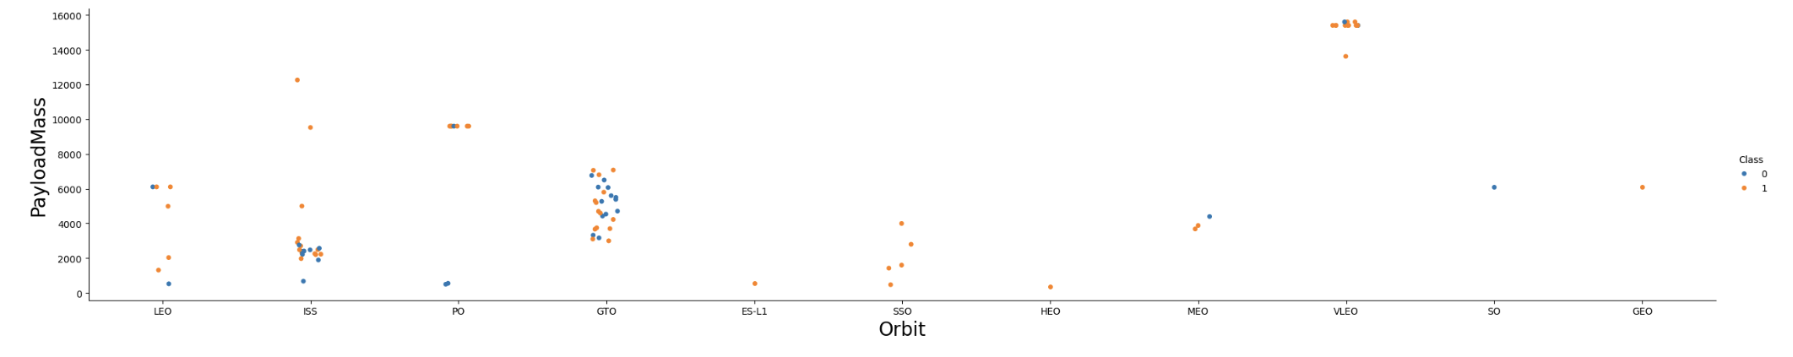
Payload vs. Orbit Type

Slide 23
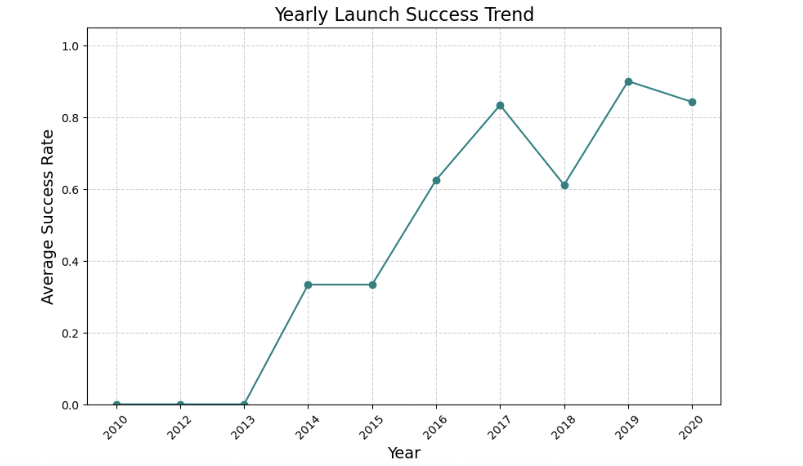
Launch Success Yearly Trend

Slide 24
All Launch Site Names
Name of All Launch Site Names
1. CCAFS SLC-40 (Cape Canaveral)
2. KSC LC-39A (Kennedy Space Center)
3. VAFB SLC-4E (Vandenberg)
4. CCAFS LC-40 Cape Canaveral Space Force Station — Launch Complex 40.
SELECT DISTINCT "Launch_Site"
FROM SPACEXTABLE;
Used DISTINCT to de-duplicate and confirm there are 3 launch sites in the dataset.

Slide 25
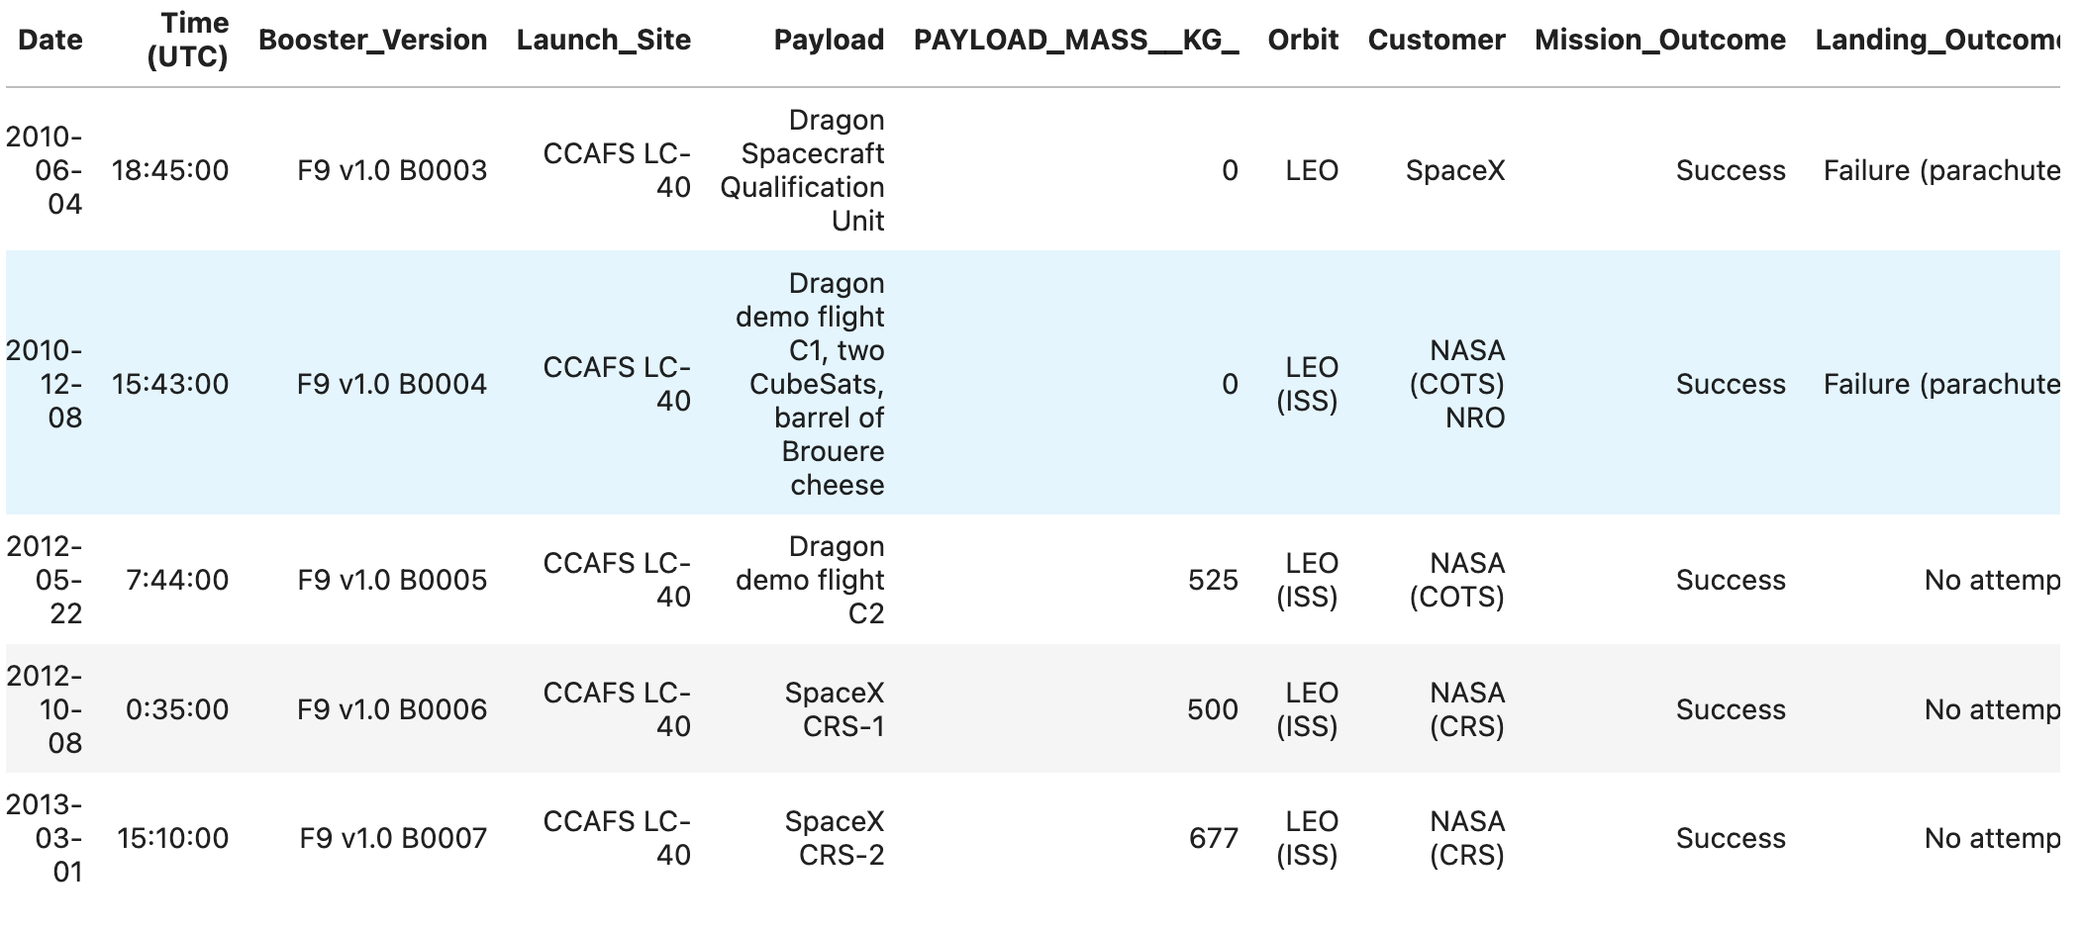
Launch Site Names Begin with 'CCA'
SELECT *
FROM SPACEXTABLE
WHERE "Launch_Site" LIKE 'CCA%'
LIMIT 5;
Returns the first 5 records from SPACEXTABLE where Launch_Site starts with "CCA" (i.e., Cape Canaveral sites).

Slide 26
Total Payload Mass
TOTAL_NASA_CRS_PAYLOAD: 111268
SELECT SUM("PAYLOAD_MASS__KG_") AS TOTAL_NASA_CRS_PAYLOAD
FROM SPACEXTABLE
WHERE "Payload" LIKE '%CRS%’
the total payload mass (kg) for all missions whose Payload field contains “CRS” is 111268

Slide 27
Average Payload Mass by F9 v1.1
AVG_PAYLOAD_F9_V1_1 :2534.67
SELECT AVG("PAYLOAD_MASS__KG_") AS AVG_PAYLOAD_F9_V1_1
FROM SPACEXTABLE
WHERE "Booster_Version" LIKE "F9 V1.1%"
Computes the average payload mass for launches whose Booster_Version starts with “F9 V1.1”; the result (2,534.7 kg) means Falcon 9 v1.1 flights carried about 2.5 tons on average

Slide 28
First Successful Ground Landing Date
SELECT MIN(Date) AS First_Successful_Ground_Landing
FROM SPACEXTABLE
WHERE
"Landing_Outcome" LIKE '%Success%’
AND "Landing_Outcome" LIKE '%ground pad%’
First_Successful_Ground_Landing: 2015-12-22
Finds the earliest (MIN) launch date with a successful ground-pad landing; the result 2015-12-22 tells us SpaceX’s first on-land booster landing happened on Dec 22, 2015.

Slide 29
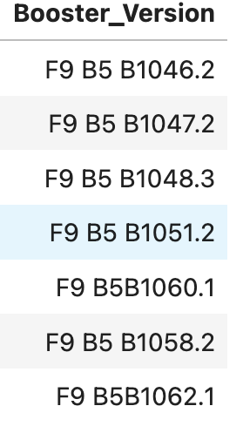
Successful Drone Ship Landing with Payload between 4000 and 6000
SELECT "Booster_Version"
FROM SPACEXTABLE
WHERE "Landing_Outcome" = 'Success'
AND "PAYLOAD_MASS__KG_" > 4000
AND "PAYLOAD_MASS__KG_" < 6000
Returns the booster versions that successfully landed on missions with payload mass between 4,000 and 6,000 kg; the results (e.g., F9 B5 B1046.2, B1047.2, B1048.3…) show several Falcon 9 Block 5 cores achieving success in that payload band.

Slide 30
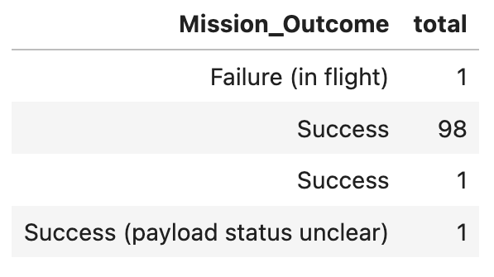
Total Number of Successful and Failure Mission Outcomes
SELECT "Mission_Outcome", Count(*) AS total
FROM SPACEXTABLE
GROUP BY "Mission_Outcome”
Counts missions by outcome: 98 “Success,” 1 “Failure (in flight), plus a few rare/duplicate labels—overall high success, with a small labeling inconsistency.

Slide 31
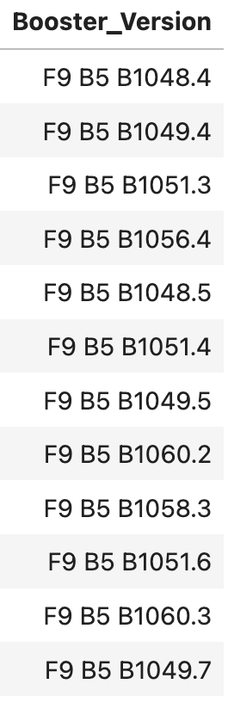
Boosters Carried Maximum Payload
SELECT "booster_version" FROM
SPACEXTABLE
WHERE "PAYLOAD_MASS__KG_" = (
SELECT MAX("PAYLOAD_MASS__KG_")
FROM SPACEXTABLE
)
This query finds all boosters whose flights carried the maximum payload mass in the table; the list of F9 B5 variants returned means multiple launches share that same highest payload value, so they all appear.

Slide 32
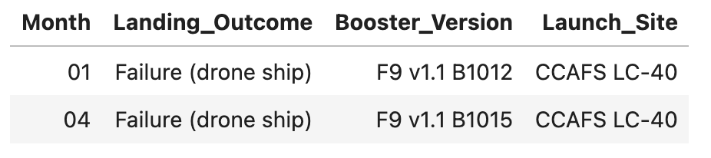
2015 Launch Records
SELECT
substr(Date, 6, 2) AS Month,
"Landing_Outcome",
"Booster_Version",
"Launch_Site"
FROM SPACEXTABLE
WHERE
substr(Date, 0, 5) = '2015' AND
"Landing_Outcome" LIKE '%failure%' AND
"Landing_Outcome" LIKE '%drone%'
This query filters 2015 launches for drone-ship landing failures and lists the month, booster version, and site; the result shows two failures—Jan (01) and Apr (04) 2015—both F9 v1.1 at CCAFS LC-40.

Slide 33
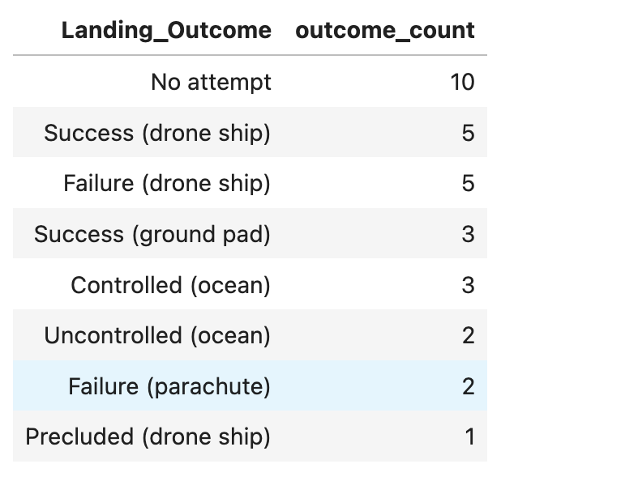
Rank Landing Outcomes Between 2010-06-04 and 2017-03-20
SELECT
"Landing_Outcome",
COUNT(*) AS outcome_count
FROM SPACEXTABLE
WHERE Date BETWEEN '2010-06-04' AND '2017-03-20'
GROUP BY "Landing_Outcome"
ORDER BY outcome_count DESC;
Counts and ranks landing outcomes between 2010-06-04 and 2017-03-20; results show “No attempt” is most common (10), followed by Success (drone ship) = 5, Failure (drone ship) = 5, Success (ground pad) = 3, etc.—i.e., many missions in that window didn’t attempt a landing, with a mix of successes and failures among attempts.

Slide 34

Section 3

Slide 35
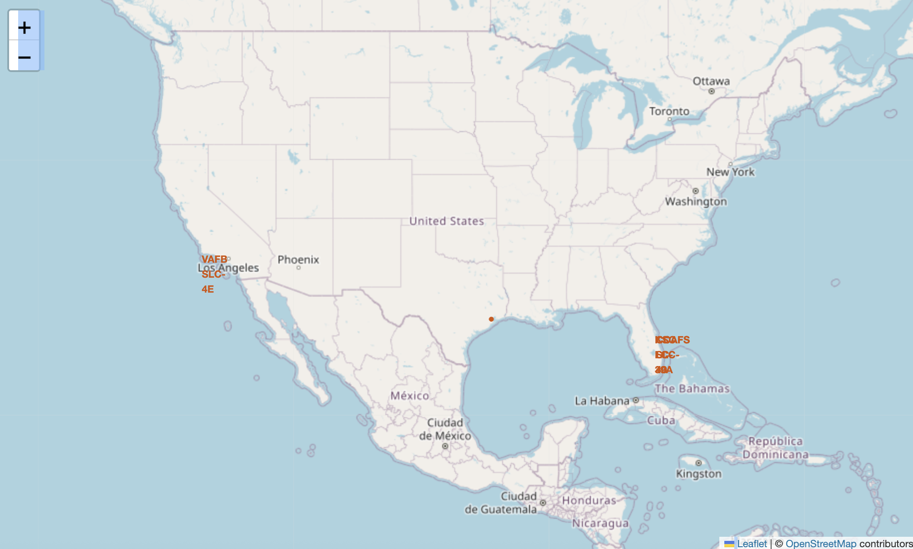
<SpaceX Launch Sites & Outcomes-Folium Overview>
Labeled site markers (orange text): VAFB SLC-4E (California) and KSC LC-39A / CCAFS SLC-40 (Florida).
All sites are on the coast so launches go over the ocean (safer) and ships can handle recoveries.
The three Florida pads (28.6°N) are closer to the equator; VAFB SLC-4E (34.6°N) is farther north.

Slide 36
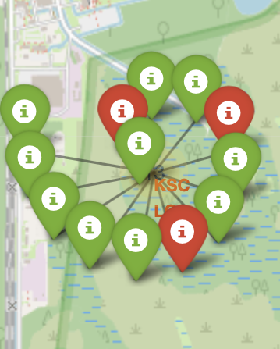
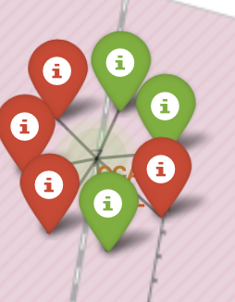
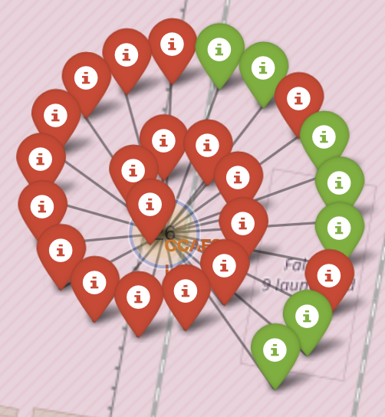
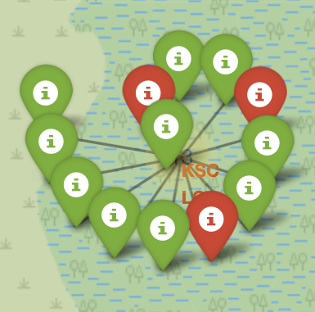
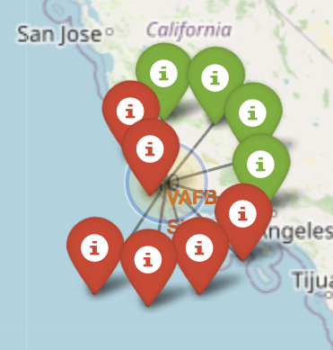
<Launch Outcomes by Site(Folium)>
CCAFS SLC-40: only 7 launches, with several red pins (failures) and fewer greens (successes) → mixed results and lower reliability here compared to KSC.
KSC cluster = lots of launches, and most pins are green → mostly successful.
CCAFS LC-40 (~26 launches): mostly failures (many red pins), only a few successes (greens).
KSC LC-39A: mostly green pins with only a few red → high success rate at this pad compared to others.
VAFB SLC-4E: about half green/half red → mixed results (lower success rate than the Florida pads).

Slide 37
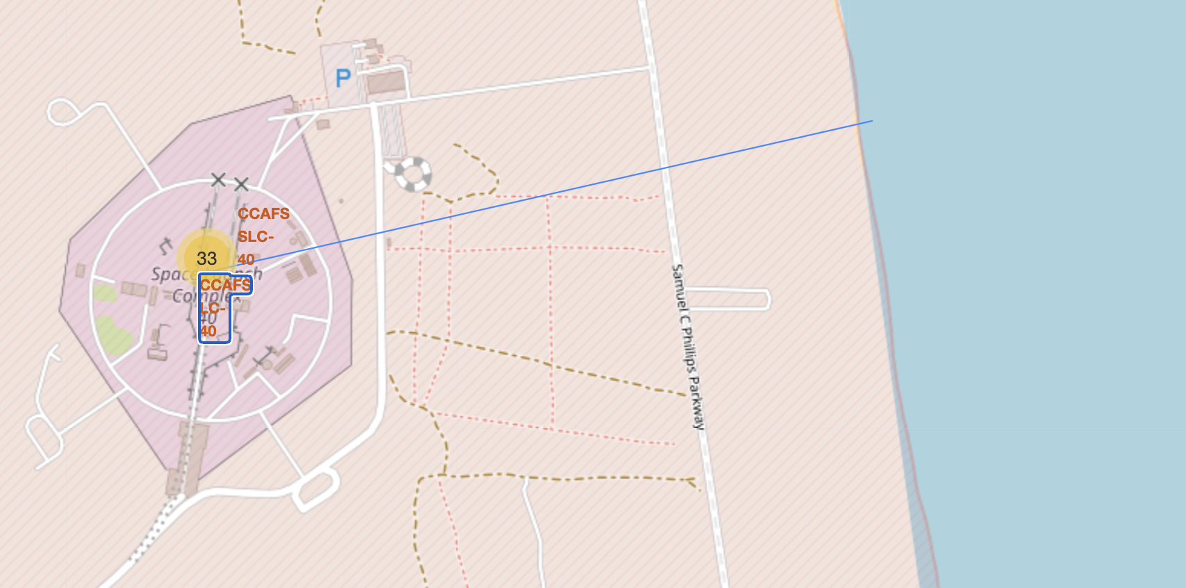
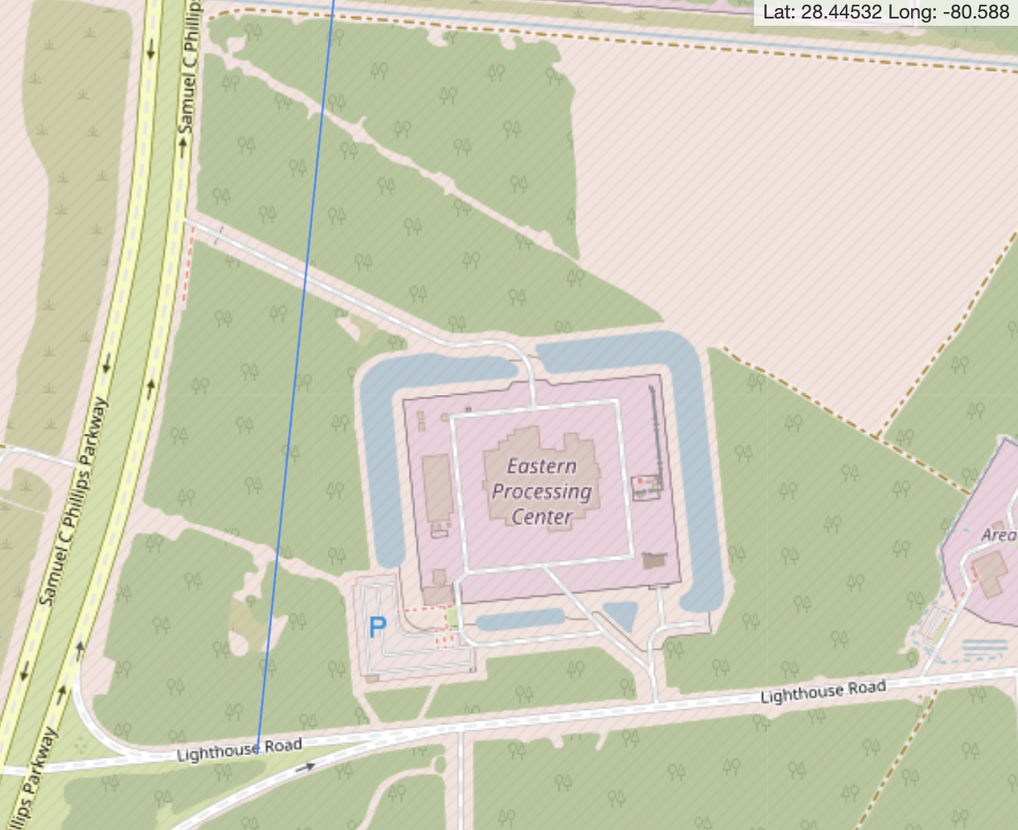
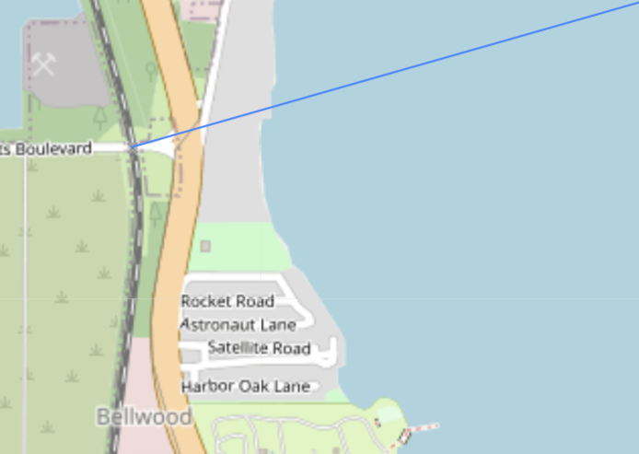
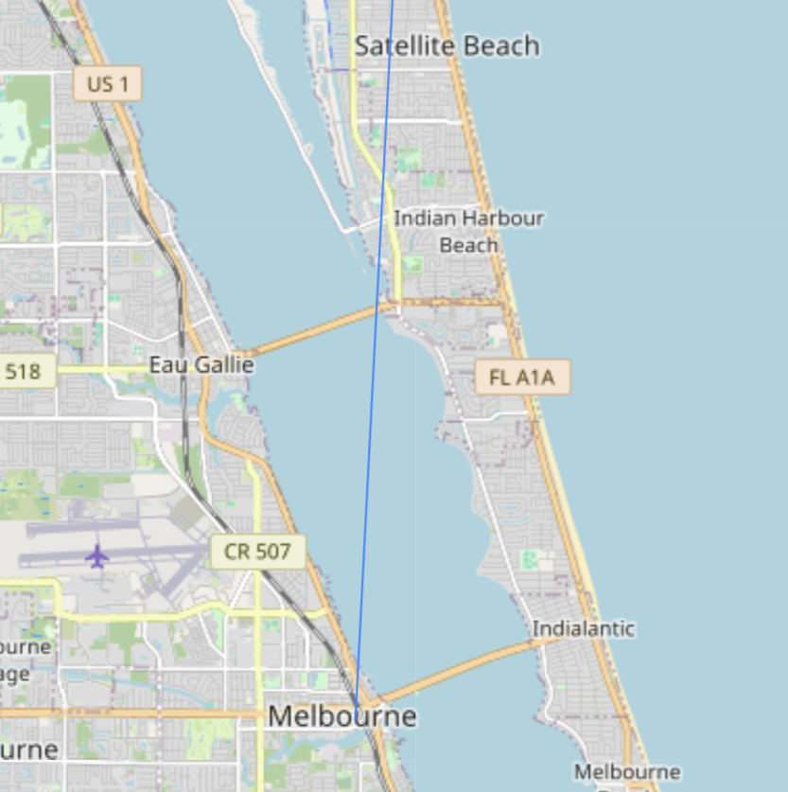
<Launch Site Proximity(Folium)>
The pad is 0.95 km from the ocean, so rockets fly out over water, keeping people and cities safer—this is why launch sites are usually on the coast.
The pad is 13 km from a highway—close enough for easy access, far enough to keep the public safely away.
The pad is 21 km from a railway far but workable: ship heavy gear by rail to a nearby hub, then truck it to the site.
The pad is 54 km from major cities on purpose, to keep people safe and cut noise.

Slide 38

Section 4

Slide 39
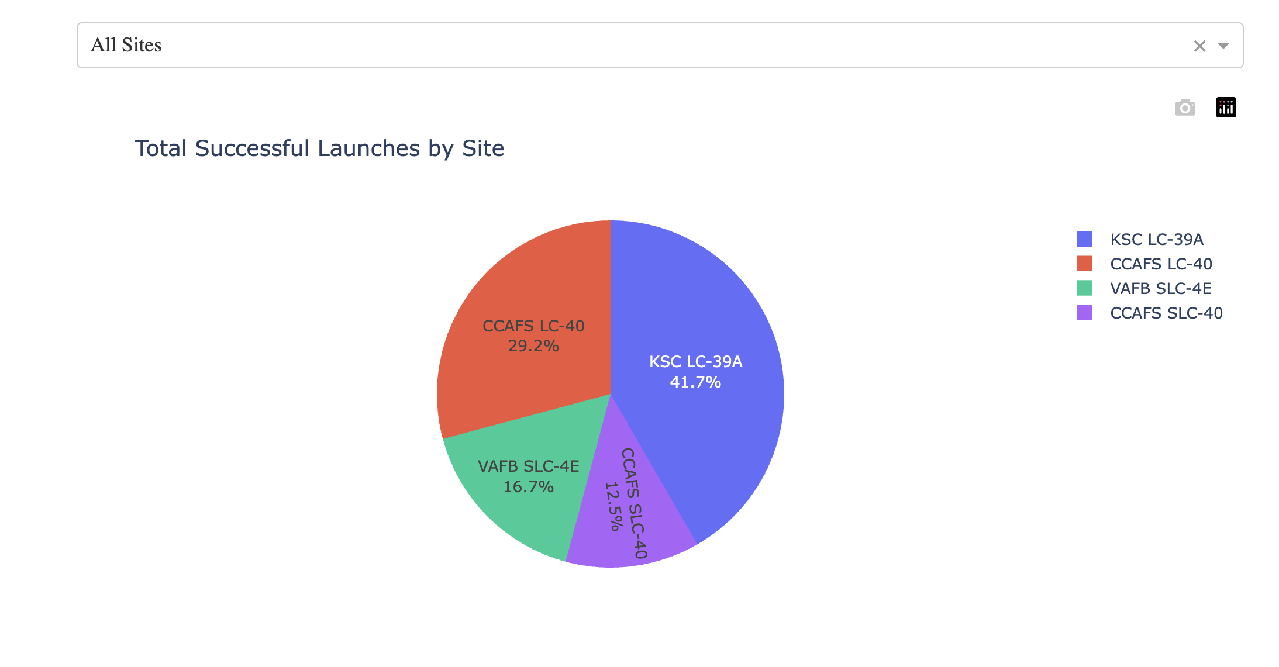
<Launch Successes by Site(Pie-All Sites)>
Florida sites (KSC LC-39A and CCAFS SLC-40) account for most successes; VAFB SLC-4E contributes fewer.

Slide 40
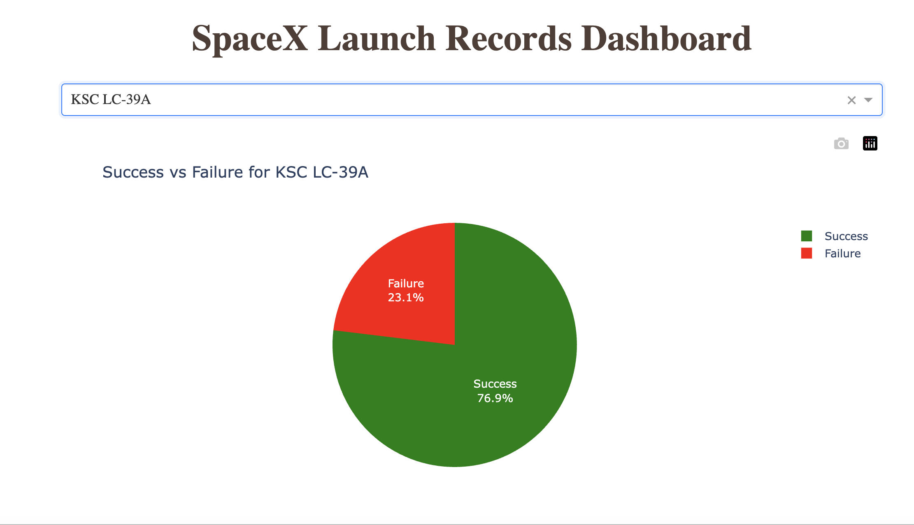
<Site With The Highest Success Rate >
KSC LC-39A shows 77% successful launches (green) vs 23% failures (red)—a strong reliability profile for this pad.

Slide 41
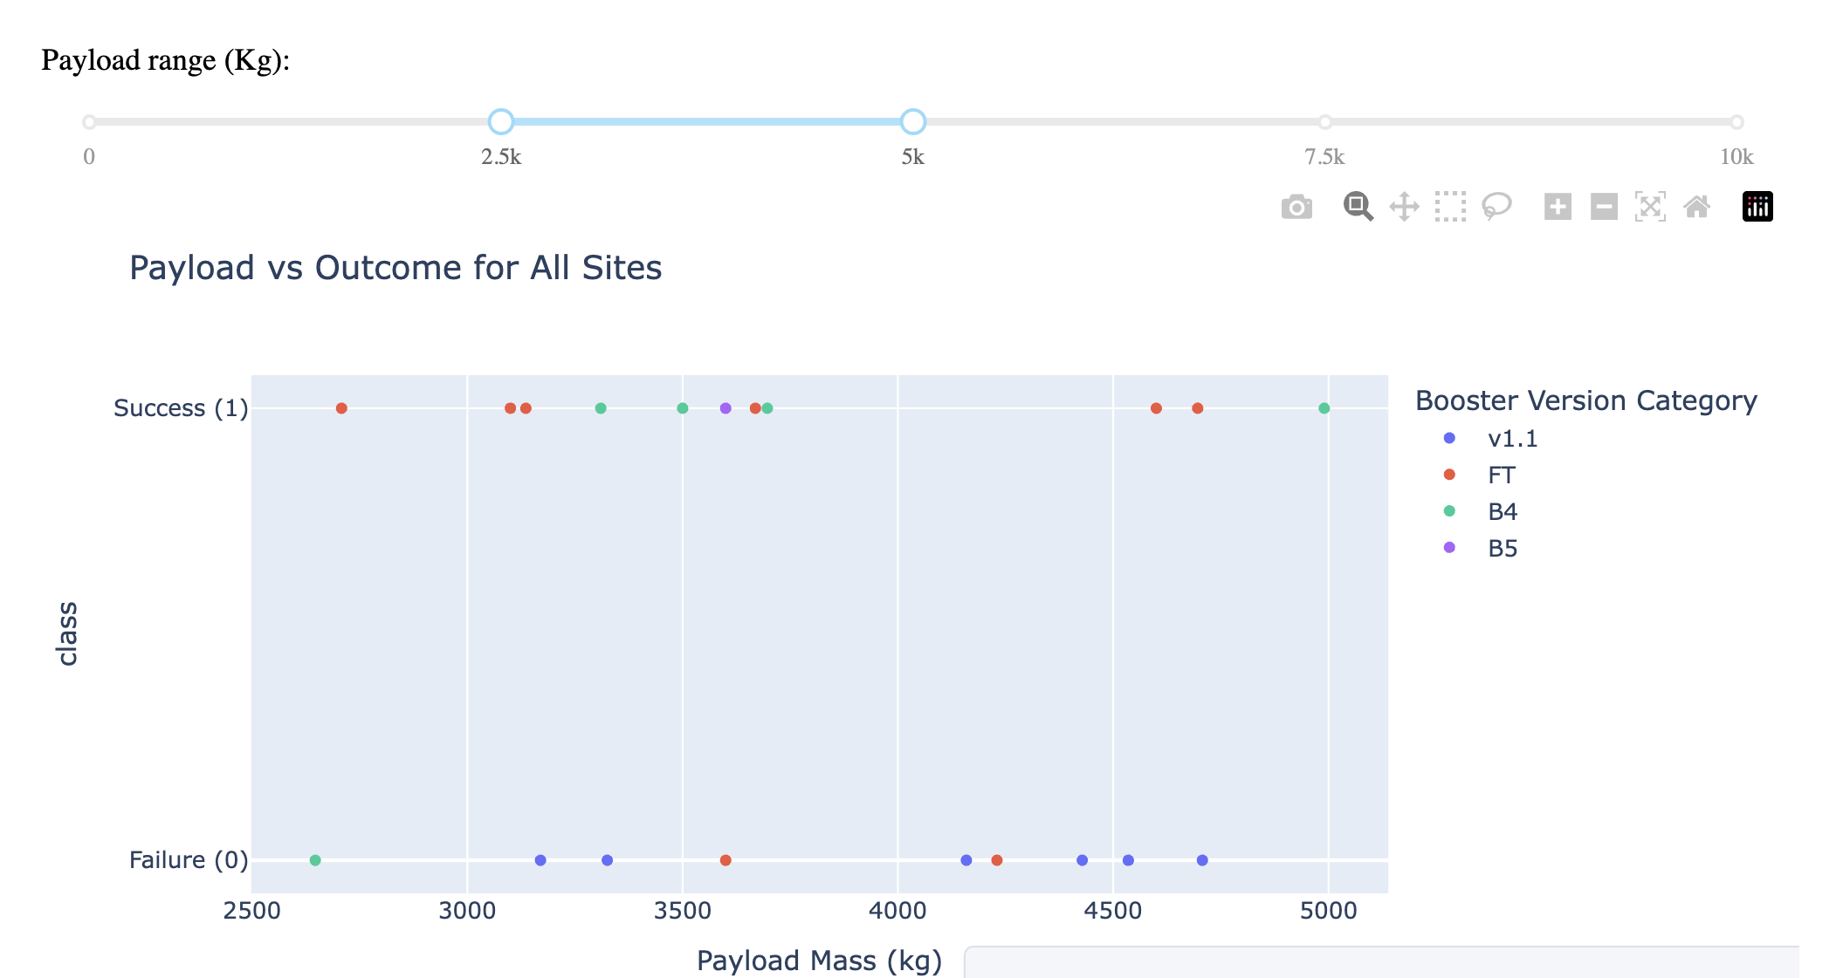
<Payload vs Outcome>
Overall success : 57% (21 successes, 12 failures).
Older boosters struggle: many v1.1 (blue) failures, especially near 4000kg–4700kg.
Newer boosters do better: Block 4 (green) is mostly successful across the band; Block 5 (purple) shows success where it appears.
Pattern: as payload approaches the top of this range, failures rise for older versions, while newer versions maintain higher success.

Slide 42

Section 5

Slide 43
Classification Accuracy
Finding: Decision Tree has the highest CV accuracy (88.8%)
Test accuracy: all models are 83.3% (tie).
The Decision Tree looked best in practice (88.8%), but in the final match all models scored 83.3%, so none proved better in real use. That’s why we say the CV edge didn’t carry over—likely just normal variance or a small test set—so there’s no clear best model from accuracy alone.

Slide 44
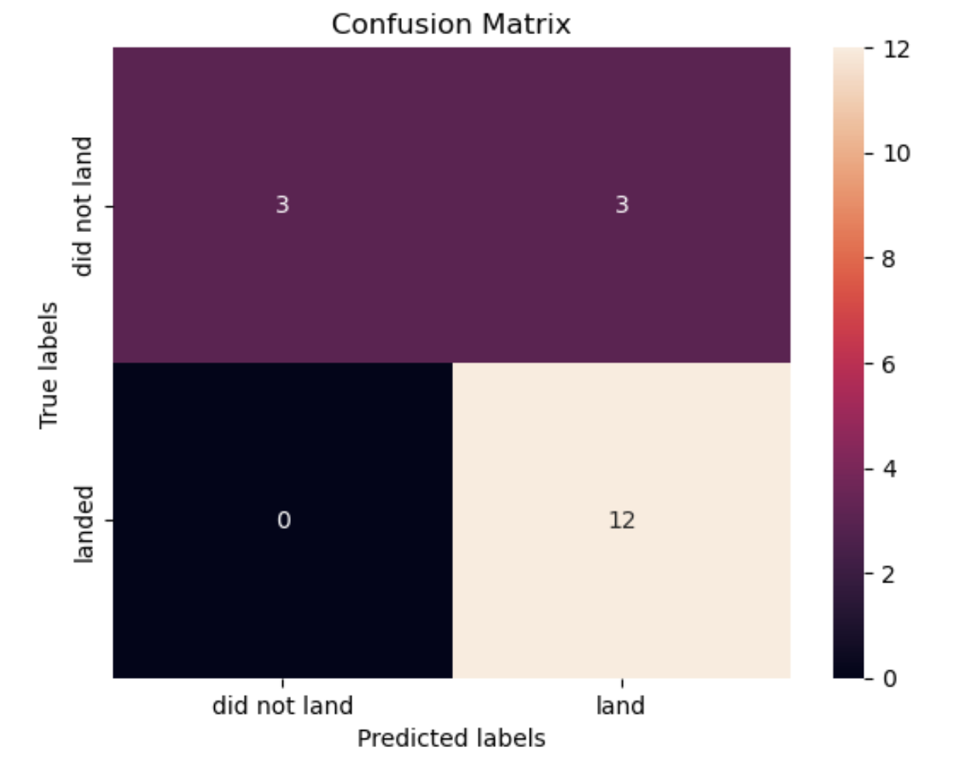
Confusion Matrix
TN (top-left = 3): correctly predicted did not land.
FP (top-right = 3): predicted land but it did not land (false alarms).
FN (bottom-left = 0): predicted did not land but it landed (missed successes) — none.
TP (bottom-right = 12): correctly predicted landed.
Key metrics from these counts (out of 18 flights):
Accuracy: (3+12)/18 = 83.3%
Recall/Sensitivity (landed): 12/(12+0) = 100% → it caught every landing.
Precision (landed): 12/(12+3) = 80% → some predicted landings were wrong.
Specificity (did not land): 3/(3+3) = 50% → weak at identifying failures.
The model is great at never missing a landing (recall 100%) but over-predicts landings, misclassifying about half of the failures as successes.

Slide 45
Conclusions
Launch Overview: CCAFS SLC-40 is the busiest pad, and it is reserved more for crew/heavy/complex payloads, ISS is the top orbit(21) by which NASA pays private companies like SPACEX to routinely fly missions to the ISS. All pads are coastal; at SLC-40 we measured 0.95 km to the ocean, 13 km to highway, 21 km to rail, 54 km to city—set up for safety and smooth operations.
Learning curve dominates: Early failures clustered at CCAFS SLC-40 referencing the(Flight Number vs. Launch Site scatter plot), success jumped after moving to KSC LC-39A and stayed high even after returning to CCAFS; the yearly success rate rose to 90% by 2019 which shows experience > site because If the pad were the main cause, success should have dropped again at CCAFS SLC-40, but it didn’t.
Payload “sweet spot” to target: 2.5–5 t has the best mix of rate and volume → 12/21 successes (≈57%). The 7.5–10 t band shows 60%, but only 5 flights (too small to rely on) very heavy payloads are rarer and riskier. Recommendation: optimize bids in 2.5–5 t.
Upgrades pay off (vehicle effect): In the 2.5–5t range, older v1.1 shows more failures near the heavy end, while Block 4/5 maintain higher success. For heavier missions, assign Block 5 when possible.
Prediction Takeaway: Simple features (one-hot + scaled) let four models reach 83.3% test accuracy (tie); Test set had 18 flights. The models all got 15/18 right → 83.3%. With so few cases, it’s easy for different models to tie on accuracy. Best confusion matrix: On those 18 flights: 12 were real landings → the model caught all 12 as “land” → Recall = 100% for “land”(it never missed a true landing), 6 were real non-landings → it only called 3 correctly as “no land” and mistook 3 as land → Specificity = 3/6 = 50%(it had 3 false alarms (“land” when it didn’t)). The data is imbalanced (12 landings vs 6 non-landings), and the model is leaning toward predicting “land” to avoid missing real landings.

Slide 46
Appendix
Data & prep (quick facts): 90+ Falcon-9 rows → one-hot + scaled features; target = Class; split 80/20 (seed=2), Train = 72, Test = 18.
Modules and Libraries Used
Data wrangling:pandas, numpy
Static charts (EDA): matplotlib.pyplot (plt), seaborn (e.g., catplot)
Interactive charts & app: plotly.express (px), dash (and from dash import dcc, html)
Maps: folium, folium.plugins → MarkerCluster, MousePosition, folium.features → DivIcon, (and basic Folium layers like Circle, Marker, PolyLine).
Machine learning (scikit-learn)
SQL: IPython SQL magic: ipython-sql (the %%sql cells), SQLite as the engine (e.g., sqlite:///my_data1.db)
Github Link for the Notebook: https://github.com/taiwotjohn13/SPACEXPROJECT/tree/main

Slide 47


